Slide 1
Census Transportation Planning Products
CTPP 2006-2010 Access Software

Slide 2
I want to get flow tables from tracts in King County, WA and Pierce County, WA to tracts in King and Pierce County, WA
Table used in this example
  A302100: Total Workers (Workers 16 years and over)
  Universe: Workers 16 years and over

Slide 3
Solution
(step-by-step illustration)

Slide 4
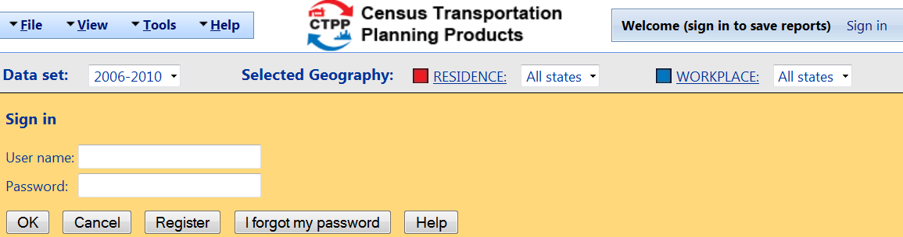
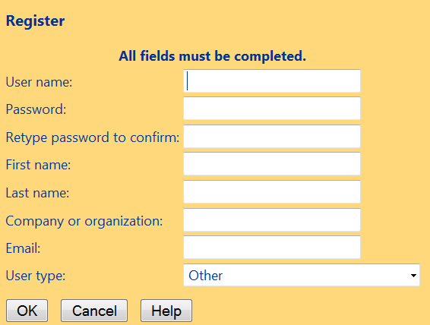
Open CTPP software web page and Sign In (or Register)
(http://ctpp.transportation.org/Pages/5-Year-Data.aspx)

Slide 5
Geography Selection

Slide 6
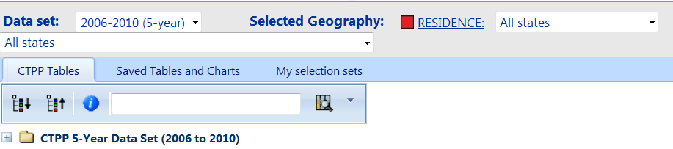
Residence Geography Selection: Step 1
Click RESIDENCE.

Slide 7
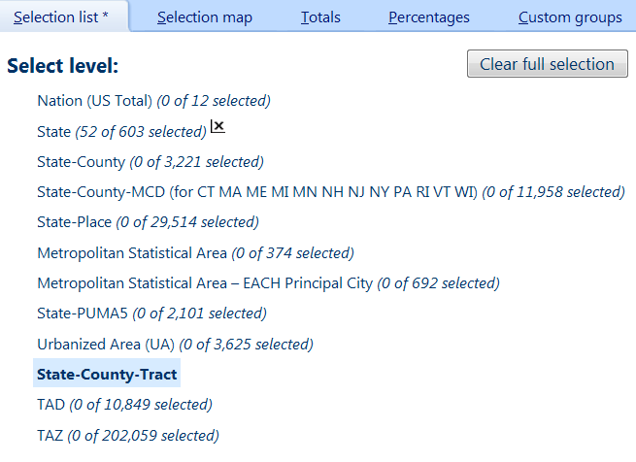
Residence Geography Selection: Step 2
Click State-County-Tract then click Clear Full Selection on the top right corner of the following page.

Slide 8
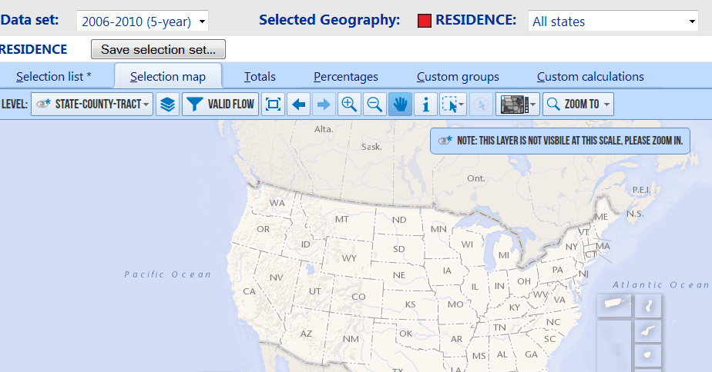
Residence Geography Selection: Step 3
Click Selection map tab.

Slide 9
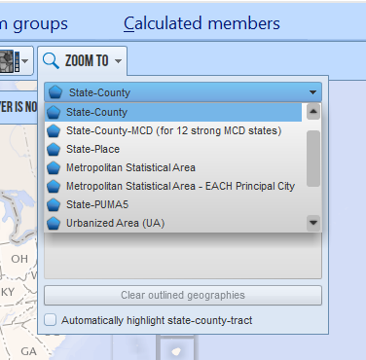
Residence Geography Selection: Step 4
Select State-County under ZOOM TO on the top right corner.

Slide 10
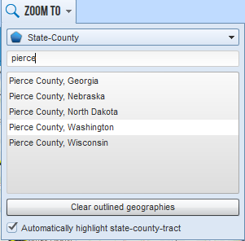
Residence Geography Selection: Step 5
Check the box next to Automatically highlight state-county-tract. Type pierce in the input box and select Pierce County, Washington from the list.

Slide 11
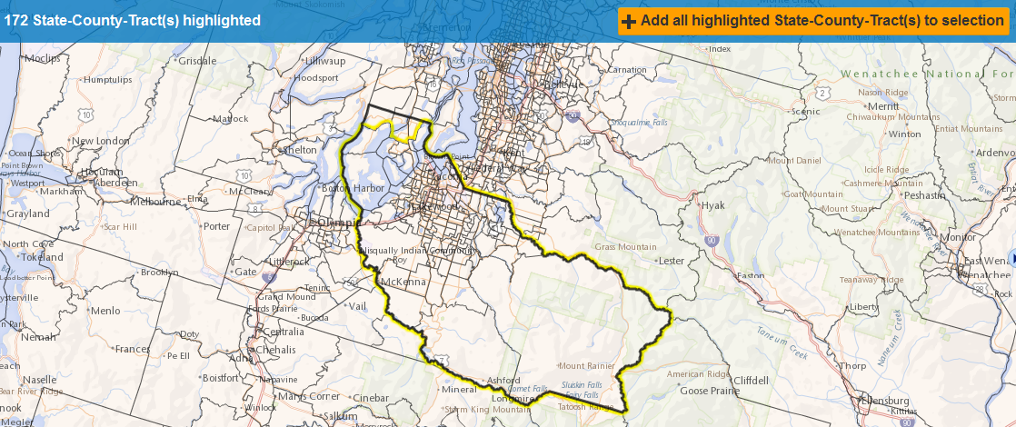
Residence Geography Selection: Step 6
Click Add all highlighted State-County-Tract(s) to selection on the top right corner.

Slide 12
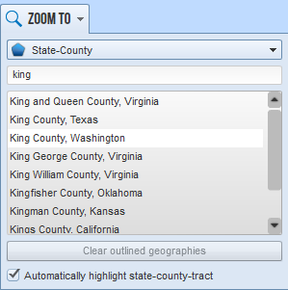
Residence Geography Selection: Step 7
Check the box next to Automatically highlight state-county-tract. Type king in the input box and select King County, Washington from the list.

Slide 13
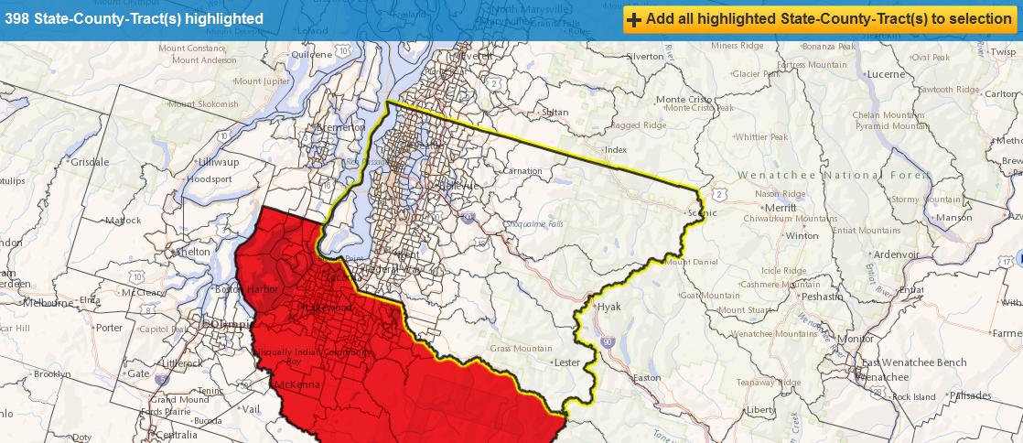
Residence Geography Selection: Step 8
Click Add all highlighted State-County-Tract(s) to selection on the top right corner.

Slide 14
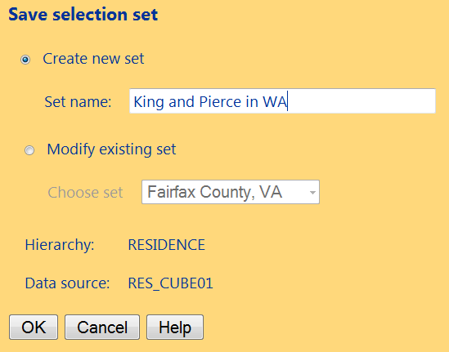
Residence Geography Selection: Step 9
Click Save selection set and type the set name in the input box Set name (shown on the bottom below)

Slide 15
Workplace Geography Selection: Step 1
Click WORKPLACE:

Slide 16
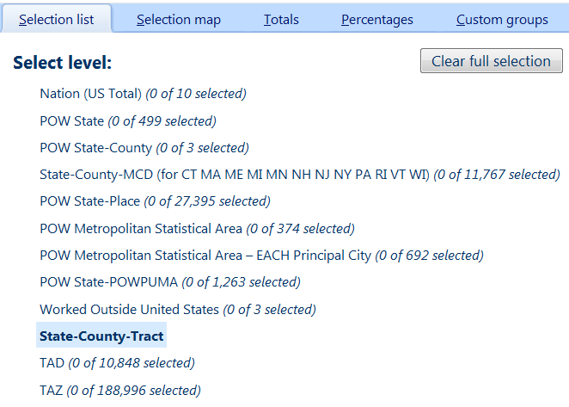
Workplace Geography Selection: Step 2
Click State-County-Tract then click Clear Full Selection on the top right corner of the following page.

Slide 17
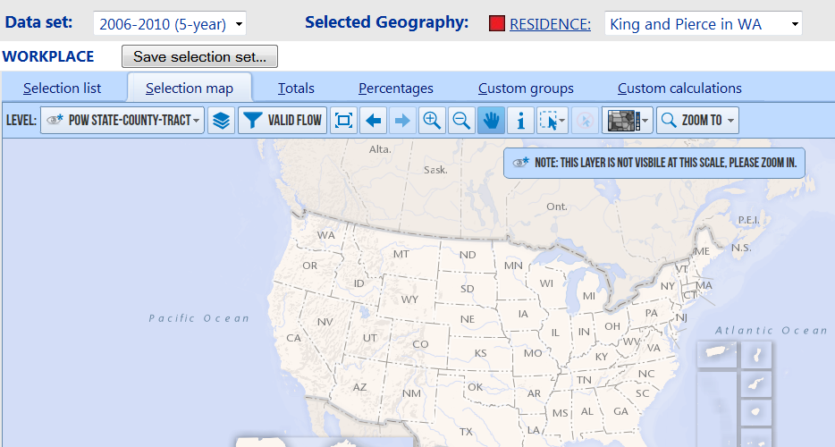
Residence Geography Selection: Step 3
Click Selection map tab.

Slide 18
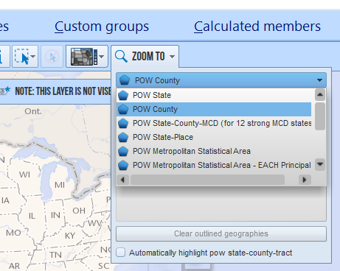
Workplace Geography Selection: Step 4
Select POW County under ZOOM TO on the top right corner.

Slide 19
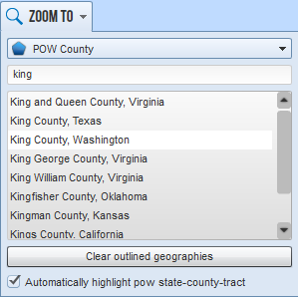
Workplace Geography Selection: Step 5
Check the box next to Automatically highlight pow state-county-tract. Type king in the input box and select King County, Washington from the list.

Slide 20
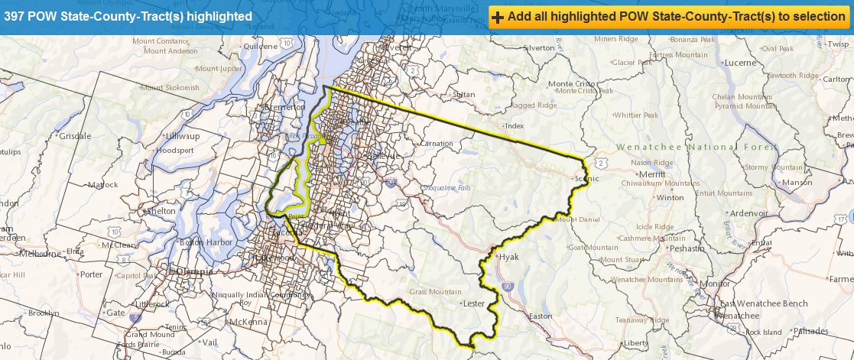
Workplace Geography Selection: Step 6
Click Add all highlighted POW State-County-Tract(s) to selection on the top right corner.

Slide 21
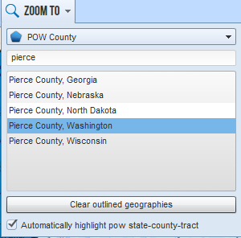
Workplace Geography Selection: Step 7
Check the box next to Automatically highlight pow state-county-tract. Type pierce in the input box and select Pierce County, Washington from the list.

Slide 22
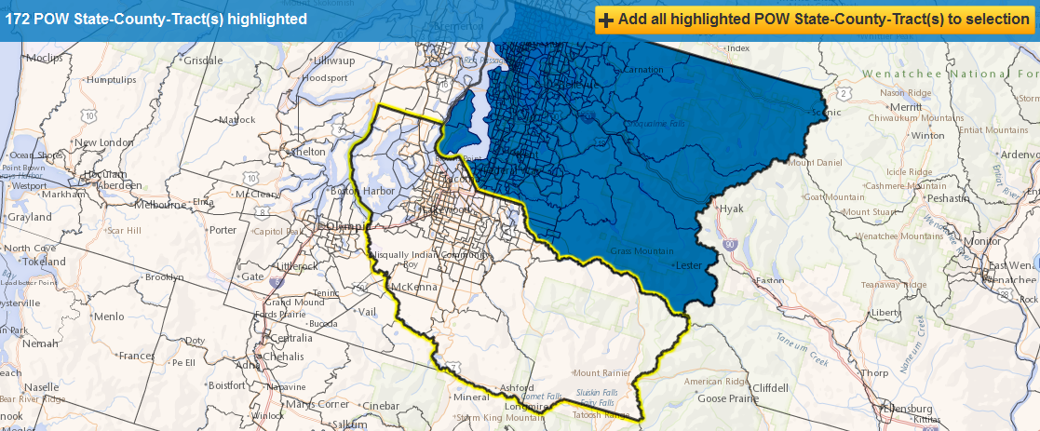
Workplace Geography Selection: Step 8
Click Add all highlighted POW State-County-Tract(s) to selection on the top right corner.

Slide 23
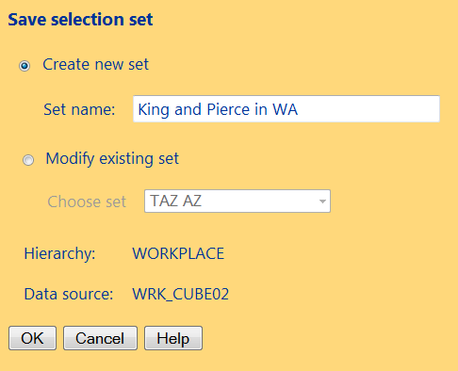
Workplace Geography Selection: Step 9
Click Save selection set and type the set name in the input box Set name (shown on the bottom below). Click OK.

Slide 24
Table Selection

Slide 25
Click Show CTPP Tables on the top right corner of the following page.

Slide 26
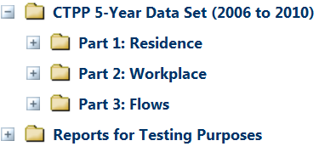
Select Part 3: Flows option.

Slide 27
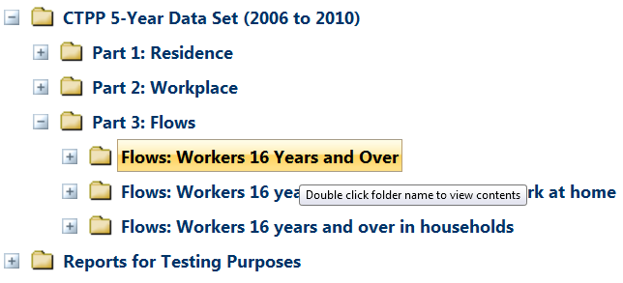
Select Flows: Workers 16 years and over option.

Slide 28
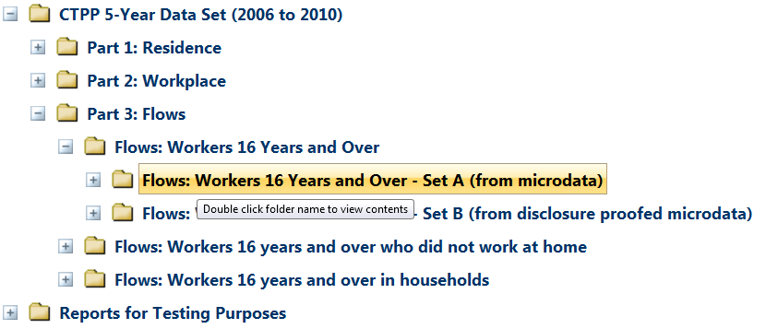
Select Flows: Workers 16 years and over – Set A (from microdata) option.

Slide 29
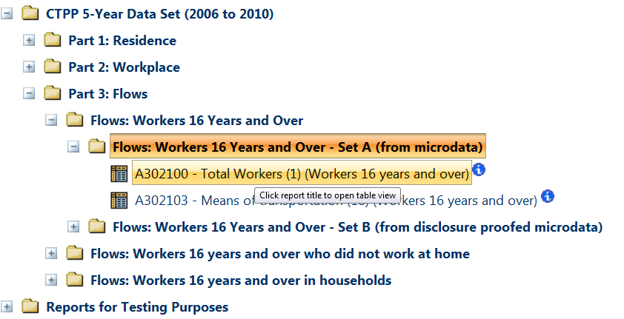
Select A302100 - Total Workers (1) (Workers 16 years and over) option.

Slide 30
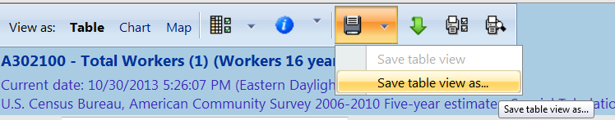
Select Save table view as on the following page.

Slide 31
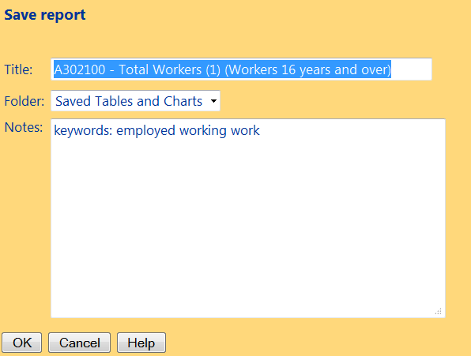
Type the Title in the input box and click OK.

Slide 32
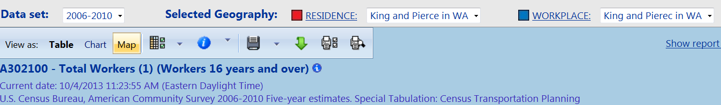
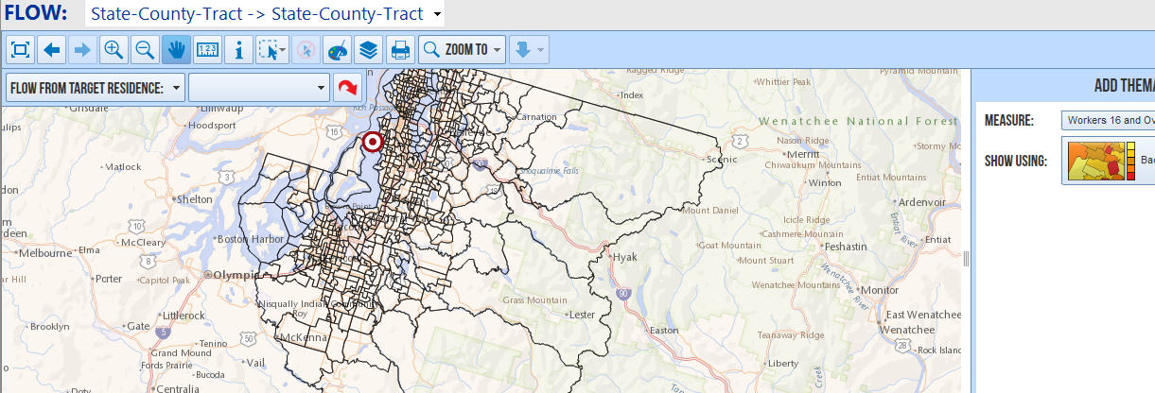
Going back to the report page and clicking Map leads to the map view of the data.

Slide 33
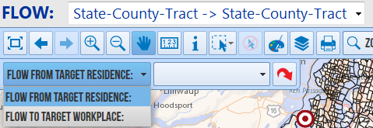
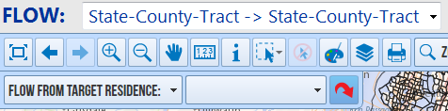
Select FLOW FROM TARGET RESIDENCE: from the drop down list on the top left corner. Click the red arrow on the right. Click on the map to define the flow origin / destination .

Slide 34
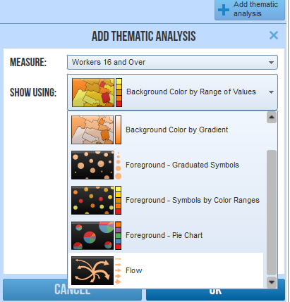
Select Flow from the drop down list in SHOW USING window and click OK.

Slide 35
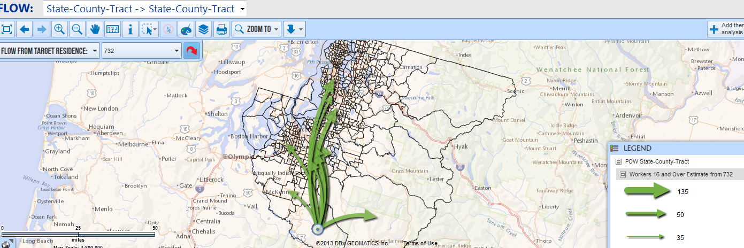
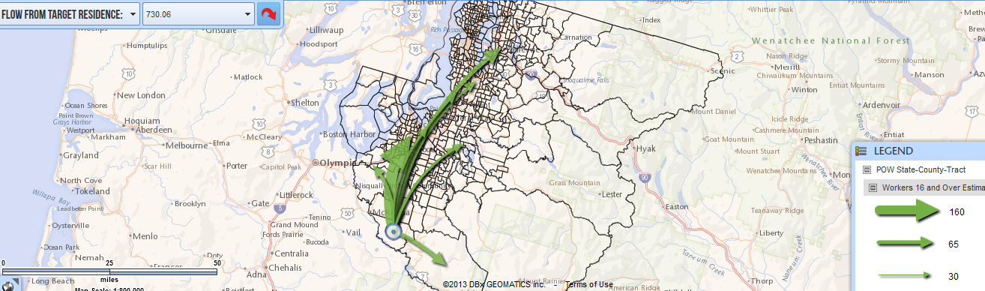
The results are shown as flows in the map. Mouse over individual green arrow to show the details information about the flow.

Slide 36
Thank You !
Questions?

